Slide 1
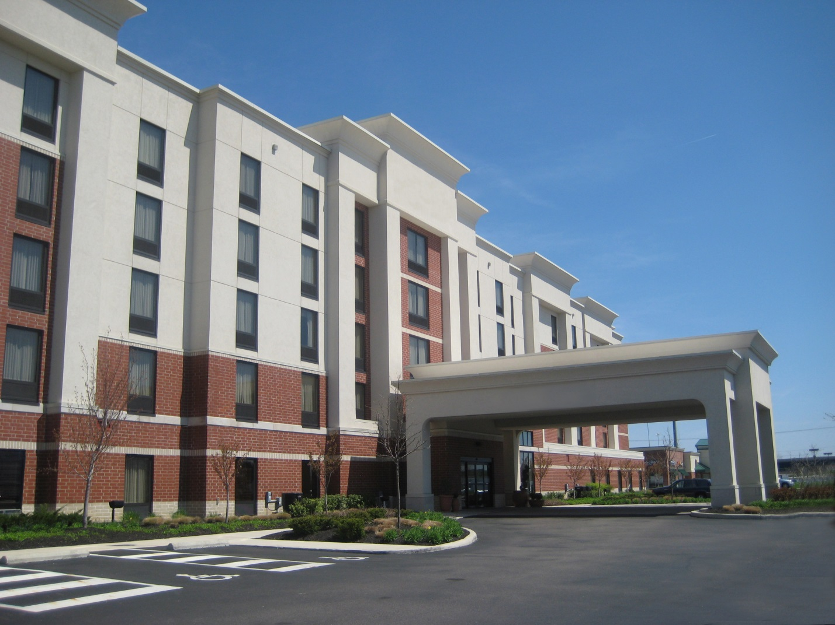
Hotel | Northeast U.S.
Jordan Rutherford | Structural Option
Faculty Advisor | Dr. Thomas Boothby
AE Senior Thesis | April 8, 2013

Slide 2
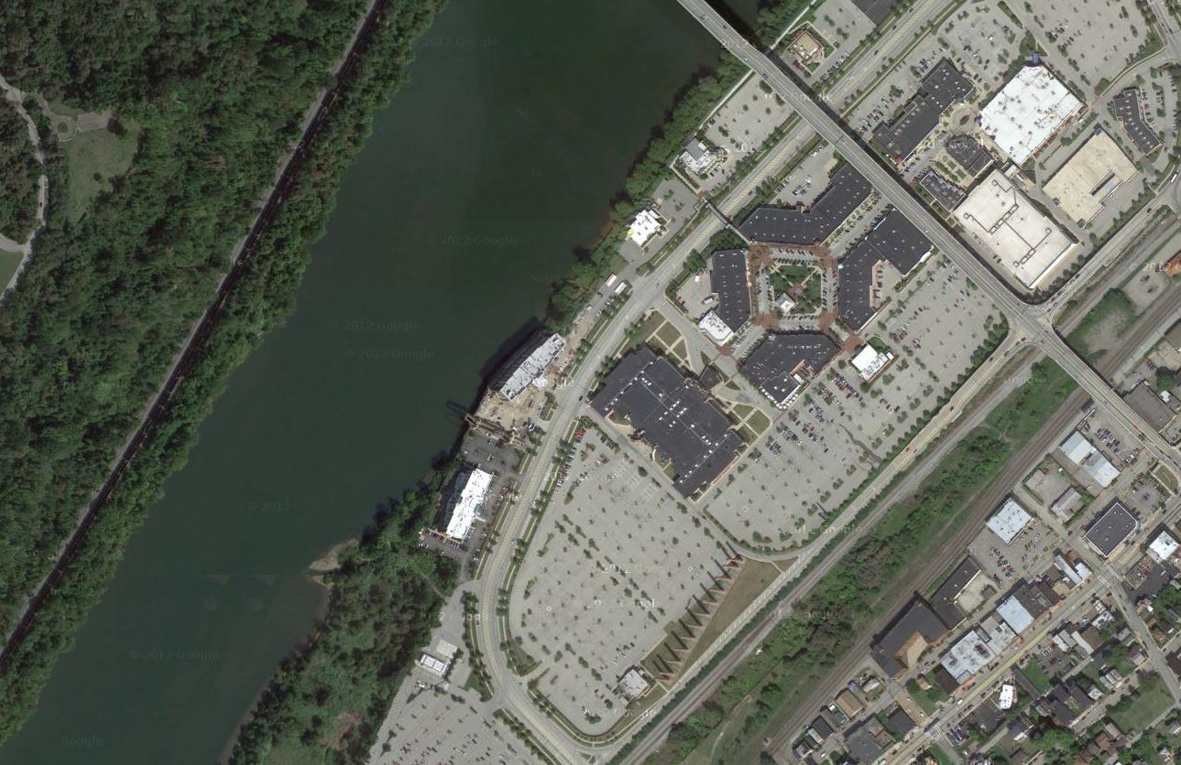
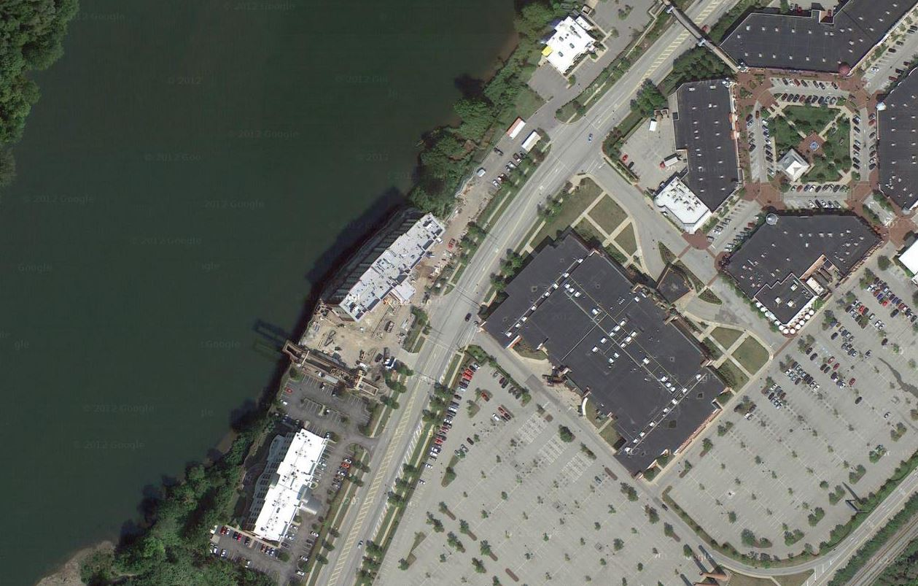
Hotel N.E.U.S.
Building Information
Site
Located in the Northeast United States
5 stories above grade
113 rooms
75,209 ft²
  63’ x 257’
Maximum Height: 60’-8”
Construction Cost: $9.2 million
October 2011 – November 2012
Building Overview
Existing Building
Problem Statement
Proposed Solution
Redesign
Conclusion

Slide 3
Hotel N.E.U.S.
Project Team
Site
Construction Manager | Continental Real Estate
Architect | Meyer and Associates
MEP | Prater Engineering Associates
Fire Protection | Prater Engineering Associates
Civil Engineer | Civil and Environmental Consultants, Inc.
Landscape Arch. | Civil and Environmental Consultants, Inc.
Structural Engineer | Atlantic Engineering Services
Building Overview
Existing Building
Problem Statement
Proposed Solution
Redesign
Conclusion

Slide 4
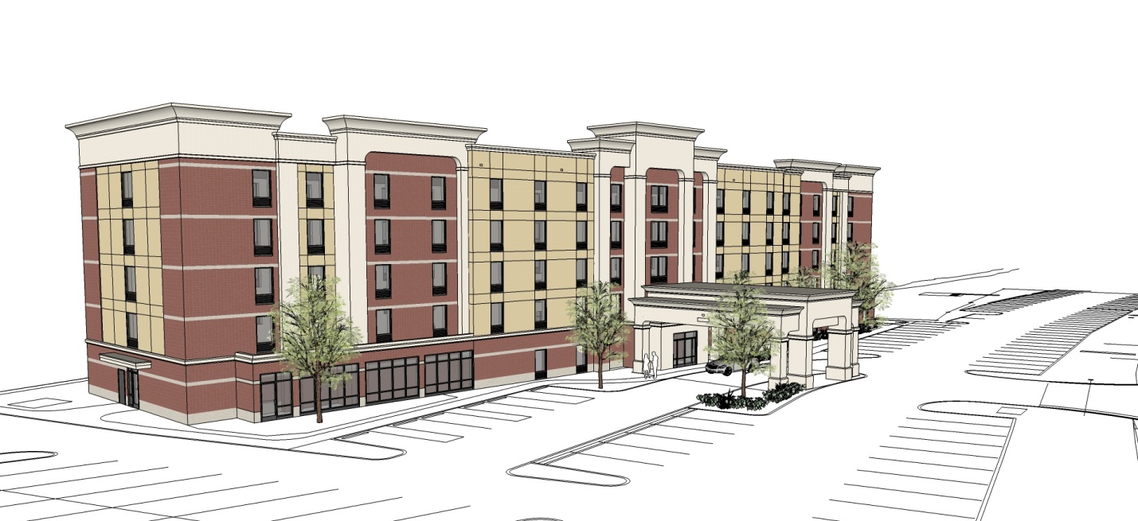
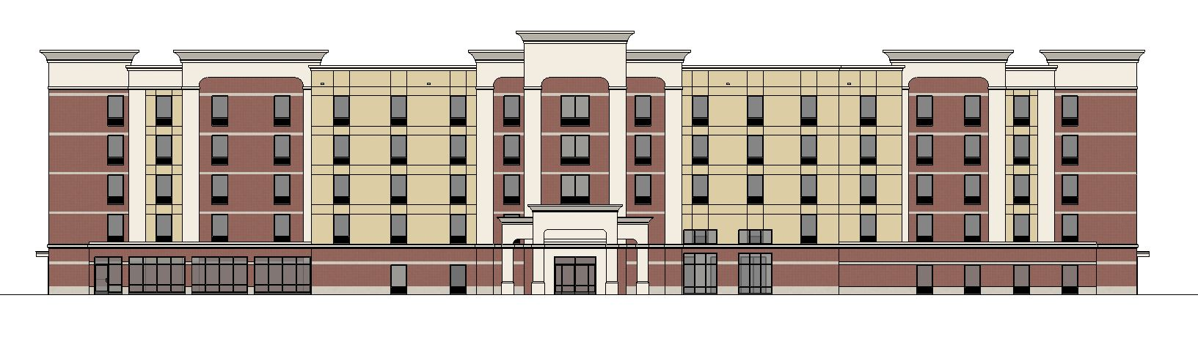
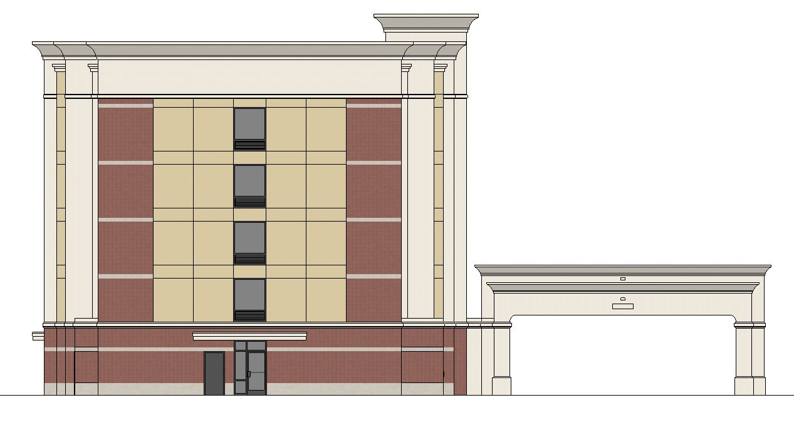
Hotel N.E.U.S.
Architecture
Elevations
Building Overview
Existing Building
Problem Statement
Proposed Solution
Redesign
Synthetic Stucco (EIFS)
Brick
Cornices
Arches
Conclusion

Slide 5
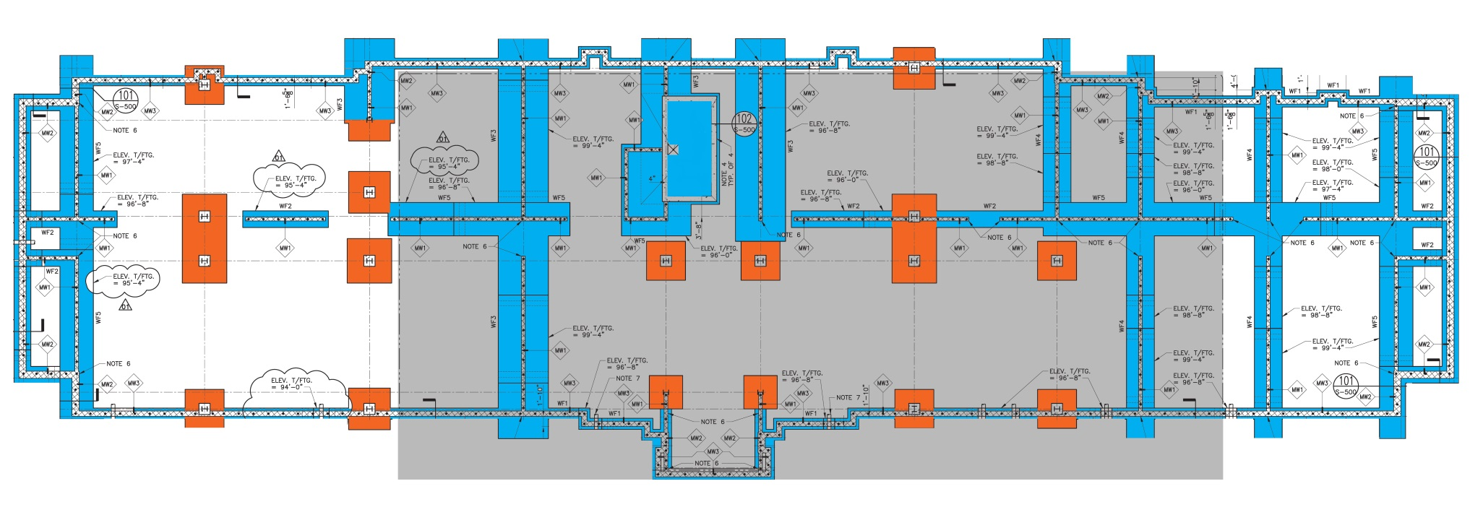
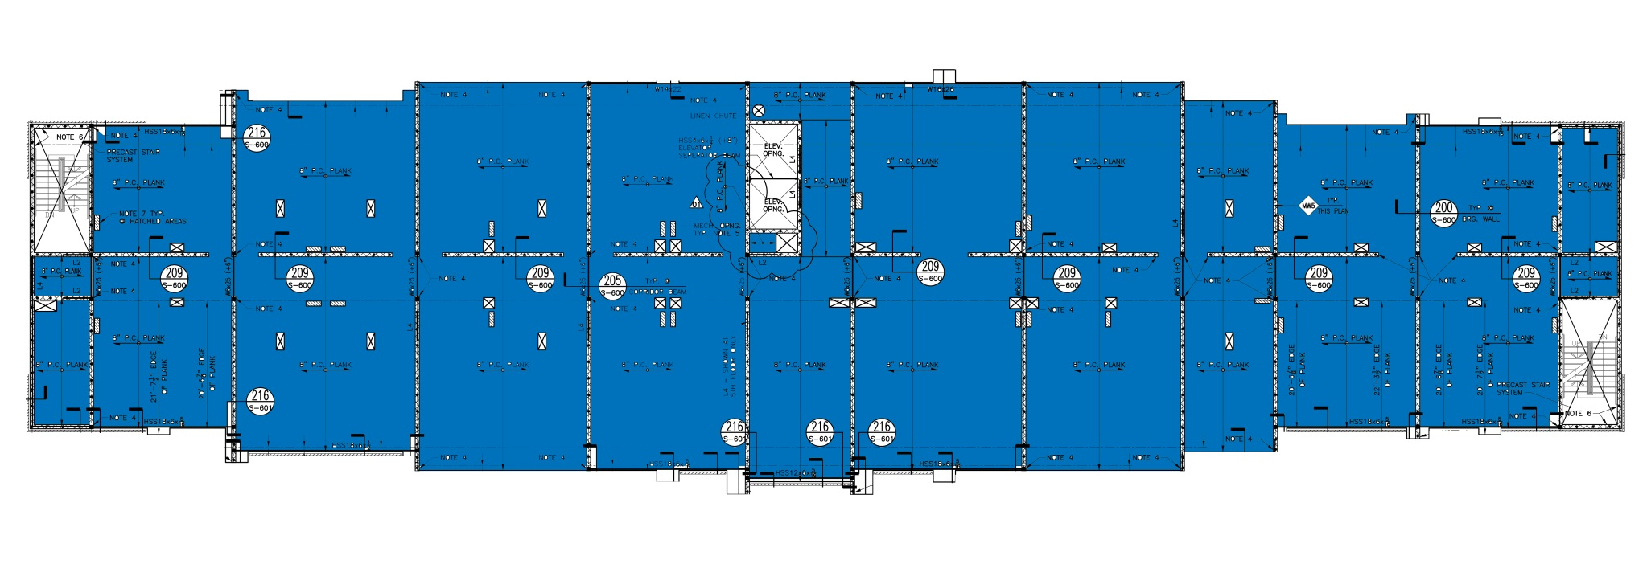
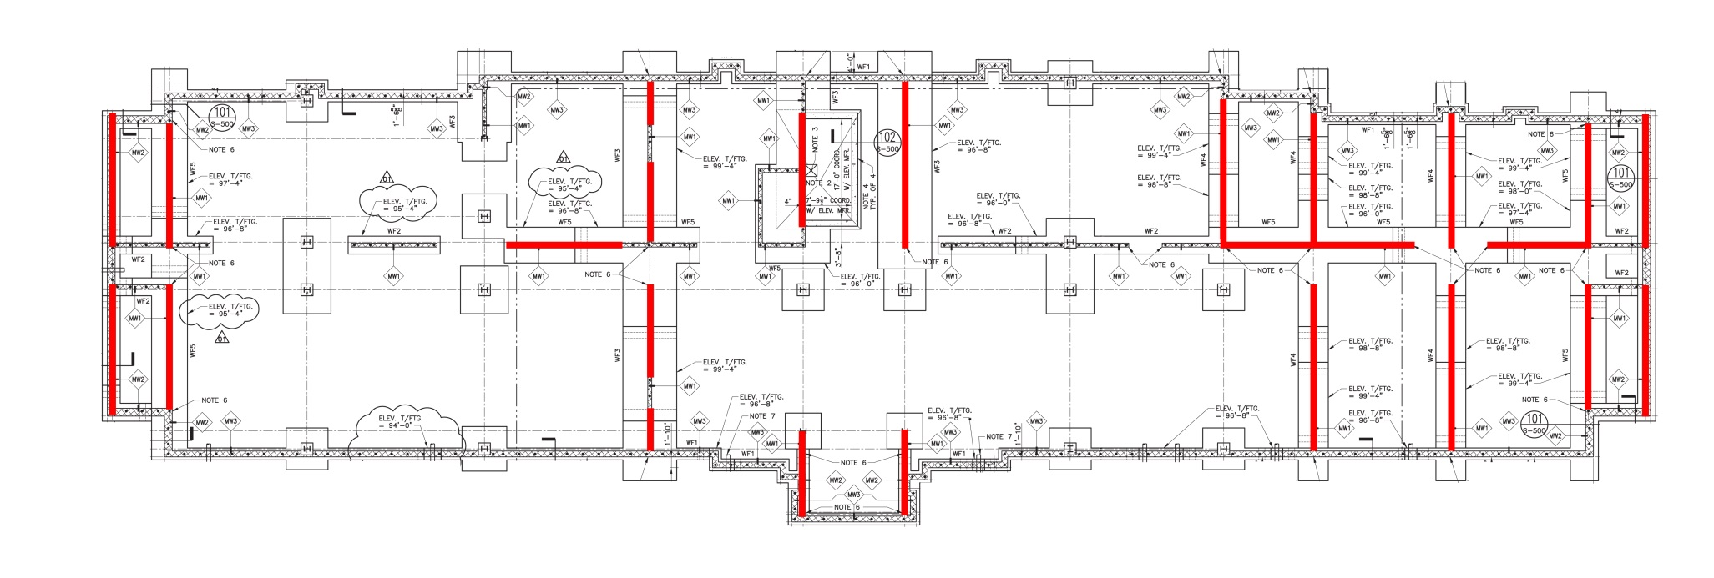
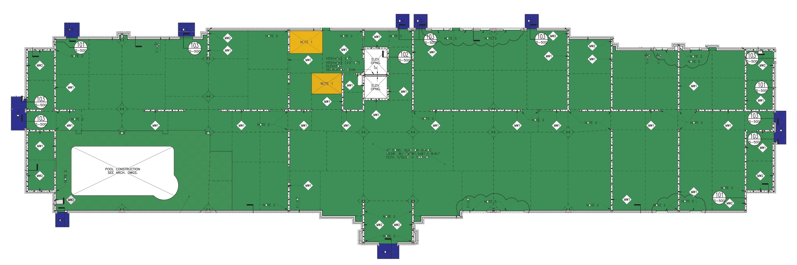
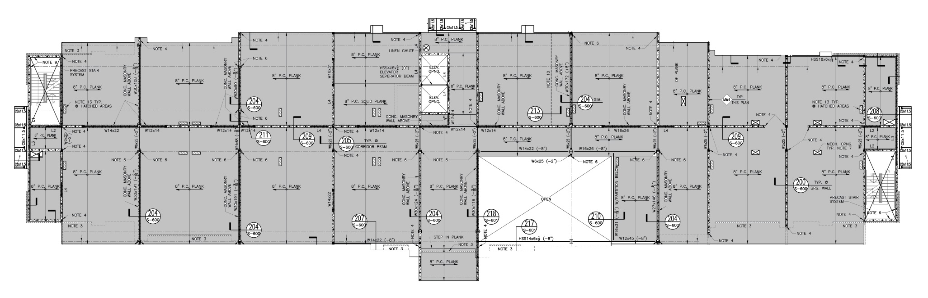
Hotel N.E.U.S.
Existing Structure
Floor Plans
Foundation | Spread and Strip Footings
Floor | Slab on grade
      | 8” Hollowcore precast Plank
Framing | Steel Beams and Columns
        | Masonry Bearing Walls
Lateral System | Masonry Shear Walls
Building Overview
Existing Building
Problem Statement
Proposed Solution
Redesign
Conclusion

Slide 6
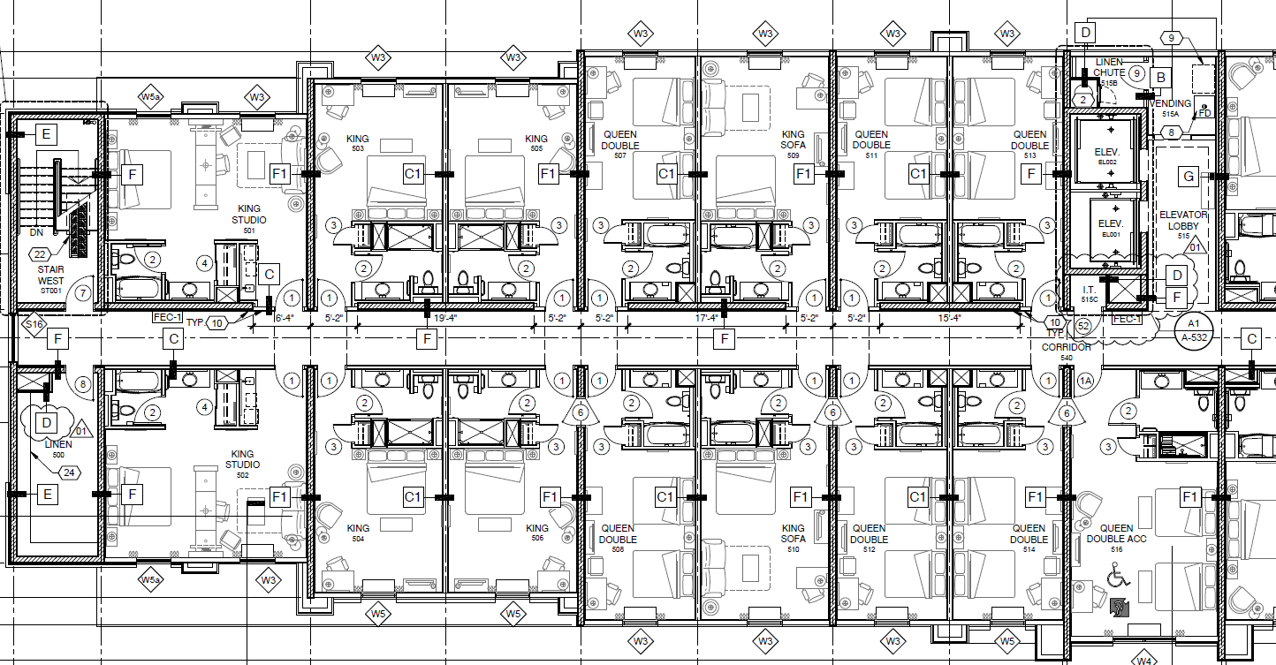
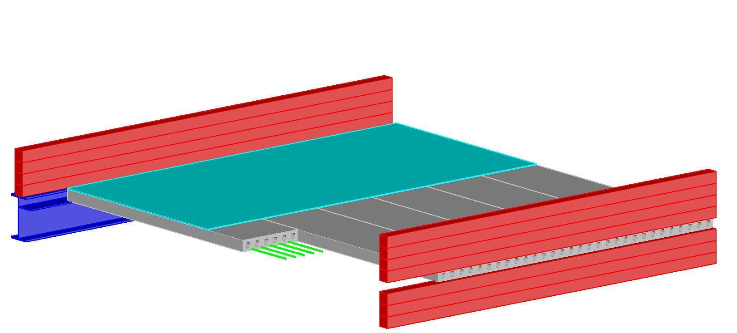
Hotel N.E.U.S.
Problem Statement
Steel / Masonry System
Open spaces on ground level
Room sizes
Lateral Elements layout
Building Overview
Existing Building
Problem Statement
Proposed Solution
Redesign
Conclusion

Slide 7
Hotel N.E.U.S.
Proposed Solution/Goals
MAE Requirements
Steel Gravity and Lateral System
Maintain floor plan and room sizes
Maintain window and door placement
Lateral Layout
AE 530- Computer Modeling of Building Structures
AE 534- Steel Connections
AE 537- Building Performance Failures and Forensic Techniques
AE 542- Building Enclosures Science Design
Building Overview
Existing Building
Problem Statement
Proposed Solution
Redesign
Conclusion

Slide 8

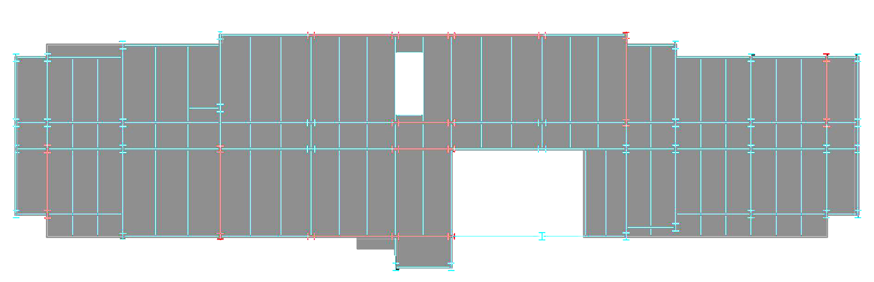
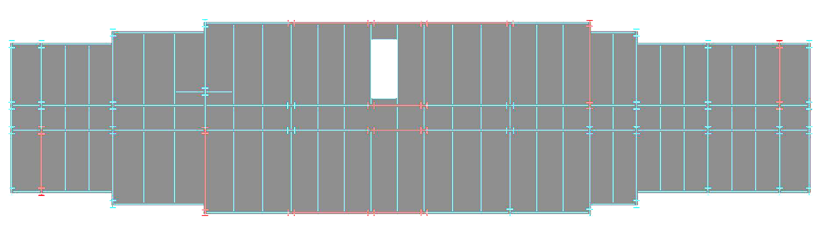
Hotel N.E.U.S.
Gravity
Building Overview
Existing Building
Problem Statement
Proposed Solution
Redesign | Gravity
Concrete on Composite Metal Deck
  5.5” total thickness
  3” flutes
Typical Beam: W14x22 (14) and W16x26 (16)
Typical Girder: W18x40 (16)
Typical Column: W10x33
Conclusion

Slide 9
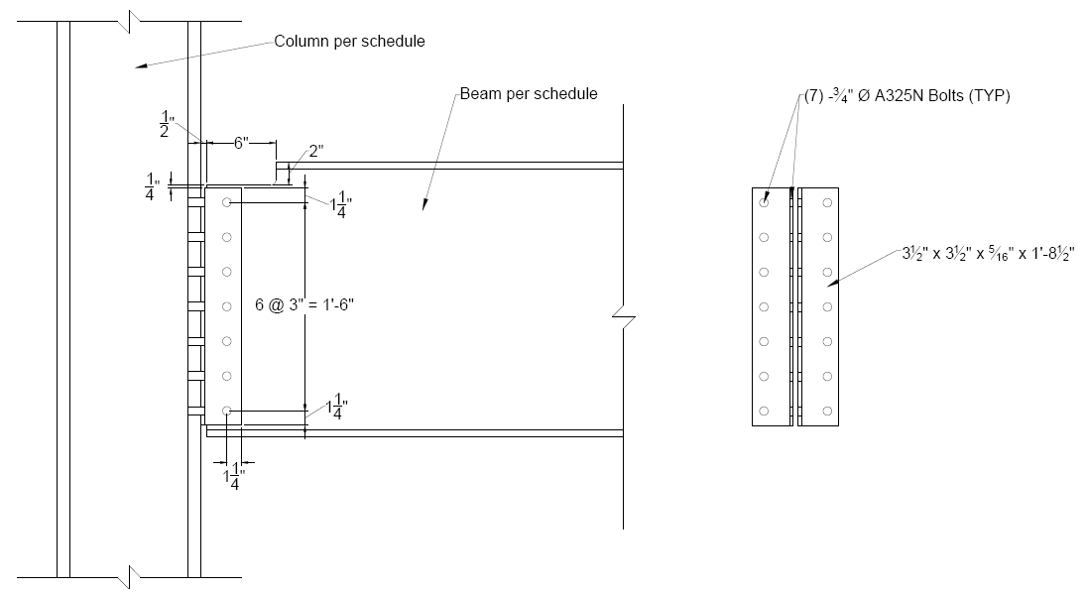
Hotel N.E.U.S.
Gravity
Connection
Building Overview
Existing Building
Problem Statement
Proposed Solution
Redesign | Gravity
Conclusion

Slide 10
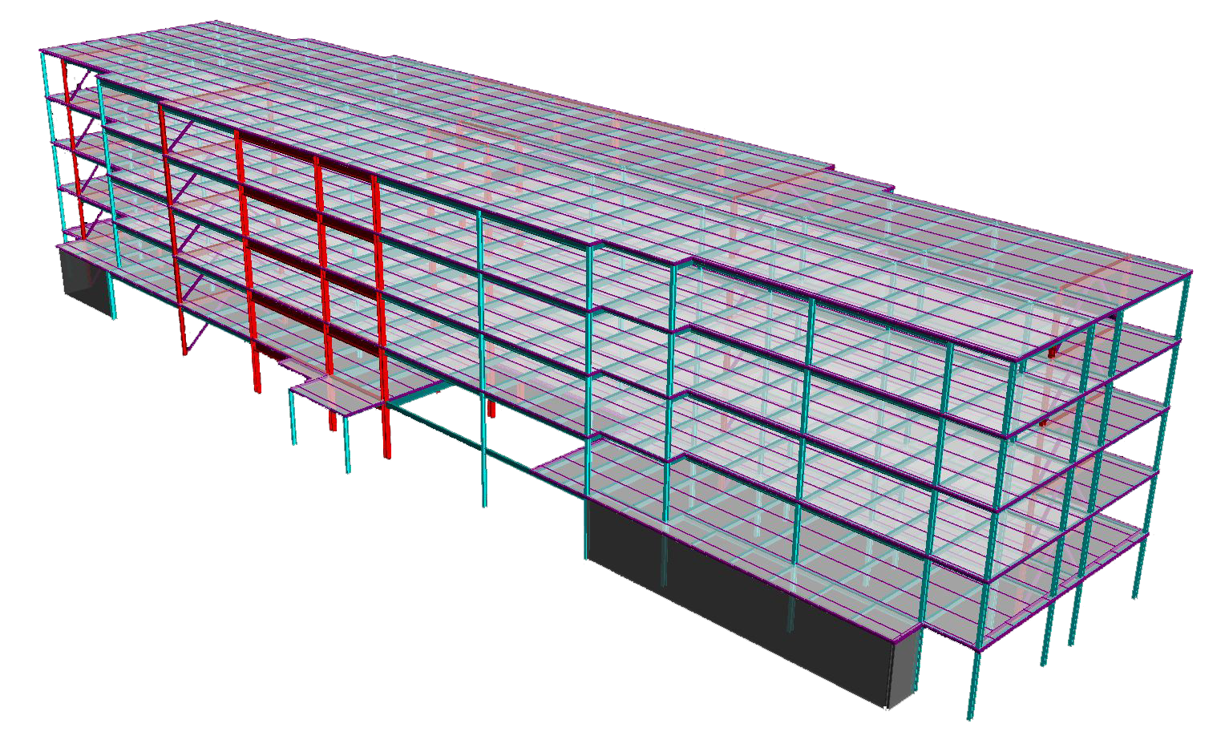
Hotel N.E.U.S.
Lateral
Building Overview
Existing Building
Problem Statement
Proposed Solution
Redesign | Lateral
Braced Frame
Moment Frame
Conclusion

Slide 11
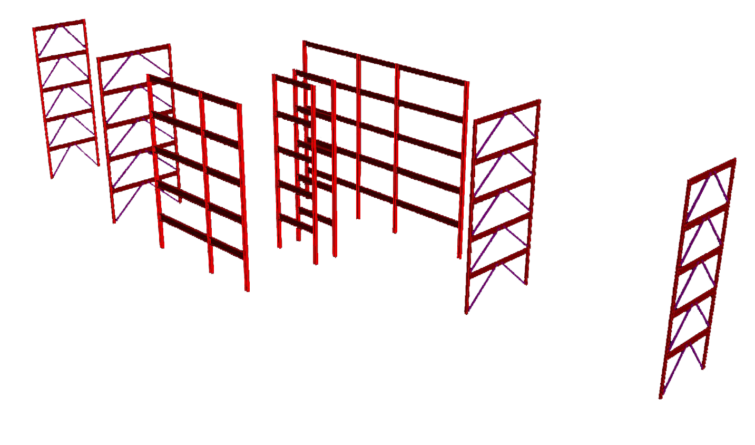
Hotel N.E.U.S.
Lateral
Center of Rigidity
Building Overview
Existing Building
Problem Statement
Proposed Solution
Redesign | Lateral
Braced Frame
Moment Frame
Conclusion

Slide 12
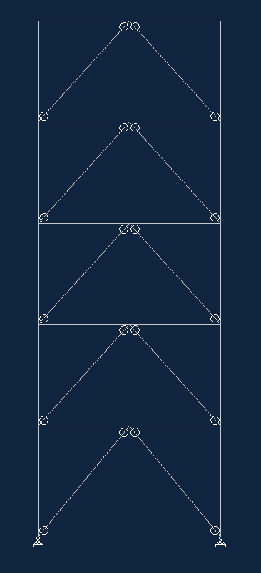
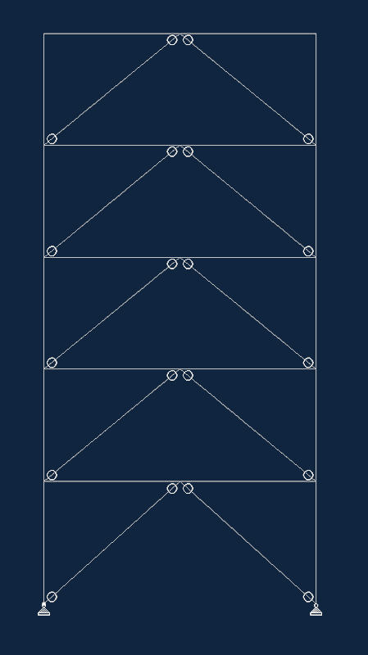
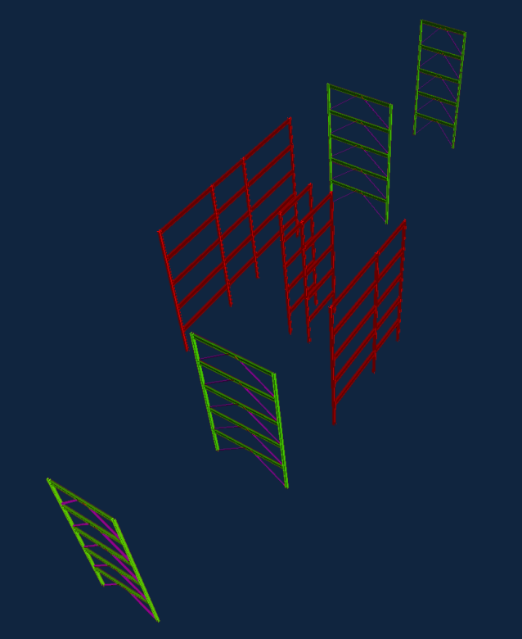
Hotel N.E.U.S.
Lateral
Braced Frames
W18x50
W18x50
HSS6x6x3/16
HSS6x6x3/16
W10x39
W10x39
W18x50
W18x50
Building Overview
HSS6x6x3/16
HSS6x6x3/16
W10x39
W10x39
Existing Building
W18x50
W18x50
Problem Statement
HSS6x6x3/16
HSS6x6x3/16
W10x39
W10x39
W18x50
W18x50
Proposed Solution
HSS6x6x3/16
HSS6x6x3/16
Replace shear walls in short direction
  One brace spans swimming area
R = 3.25
W10x39
W10x39
W18x50
W18x50
Redesign | Lateral
HSS6x6x1/4
HSS6x6x1/4
W10x39
W10x39
Conclusion

Slide 13
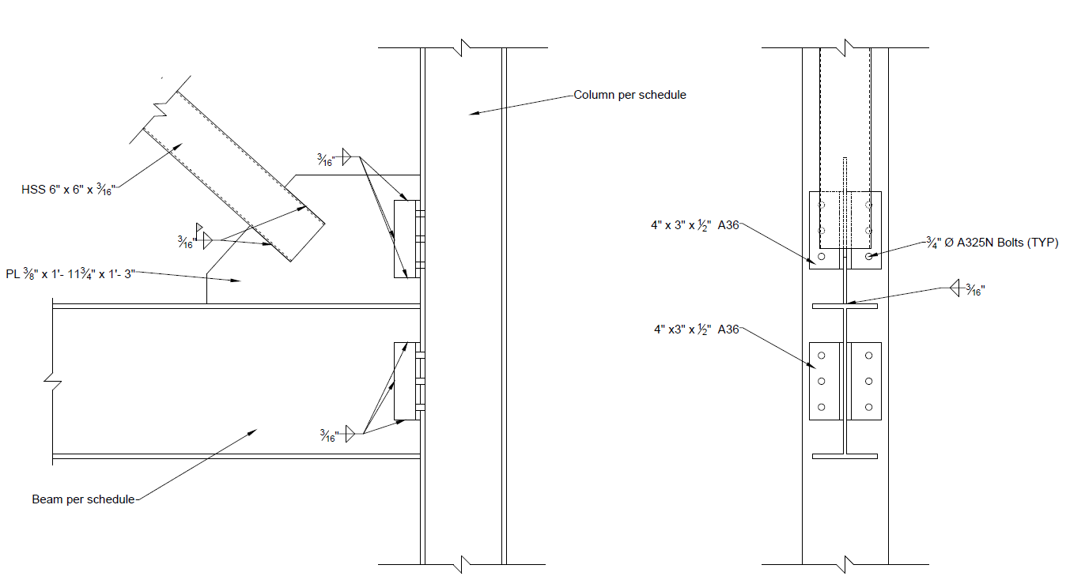
Hotel N.E.U.S.
Braced Connection
Braced Frames
Building Overview
Existing Building
Problem Statement
Proposed Solution
Redesign | Lateral
Conclusion

Slide 14

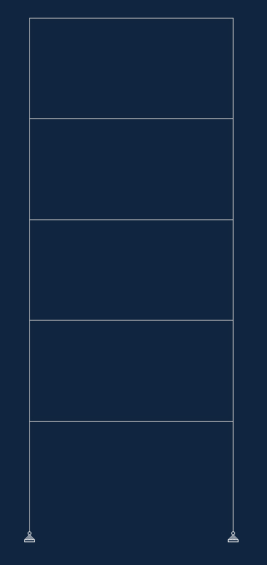
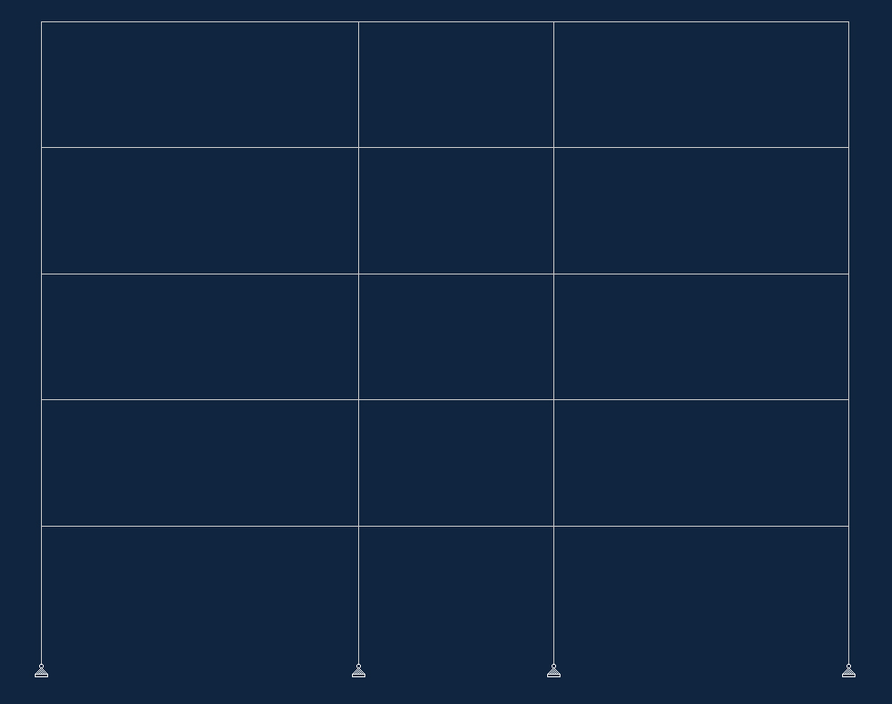
Hotel N.E.U.S.
Lateral
Moment Frames
W21x62
W21x62
W24x68
W12x65
W12x96
W12x65
W27x84
W24x68
W24x68
Building Overview
W12x96
W12x96
W12x96
Existing Building
W24x68
W27x84
W24x68
Problem Statement
W12x96
W12x96
W12x96
W27x84
W30x90
W27x84
Proposed Solution
W12x120
W12x120
W12x120
Allows for window and door openings
Pinned Base
R = 3
Redesign | Lateral
W27x84
W30x90
W27x84
Conclusion
W12x120
W12x120
W12x120

Slide 15
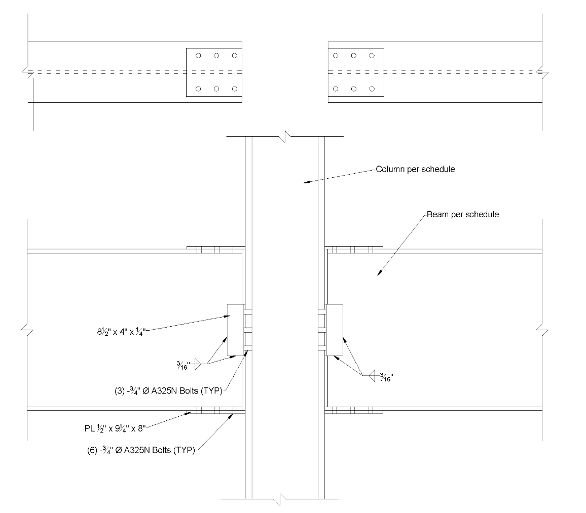
Hotel N.E.U.S.
Moment Connection
Moment Frames
W21x62
W12x96
W24x68
Building Overview
W12x96
Existing Building
W24x68
Problem Statement
W12x96
W27x84
Proposed Solution
W12x120
Redesign | Lateral
W27x84
Conclusion
W12x120

Slide 16
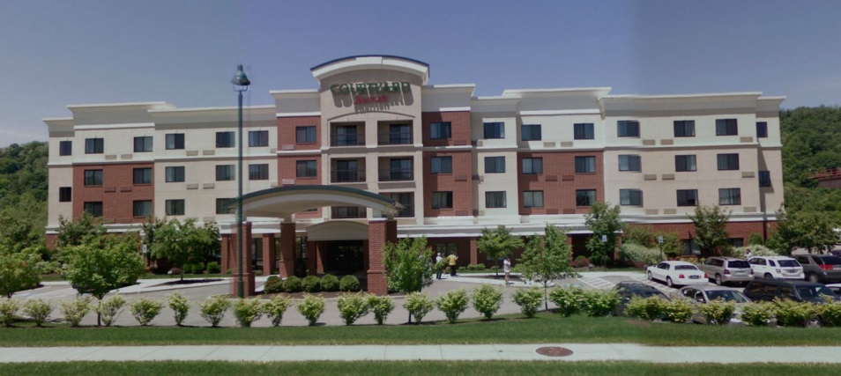
Hotel N.E.U.S.
Architecture
Existing Styles
Building Overview
Existing Building
Problem Statement
Proposed Solution
Redesign | Arch.
Conclusion

Slide 17
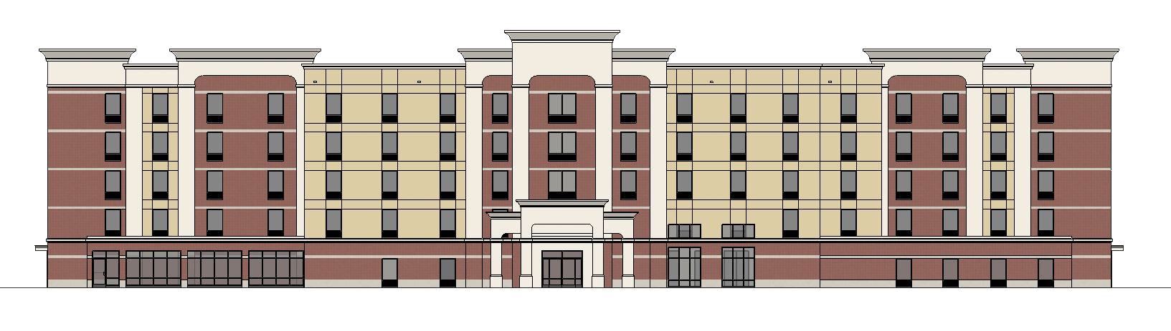
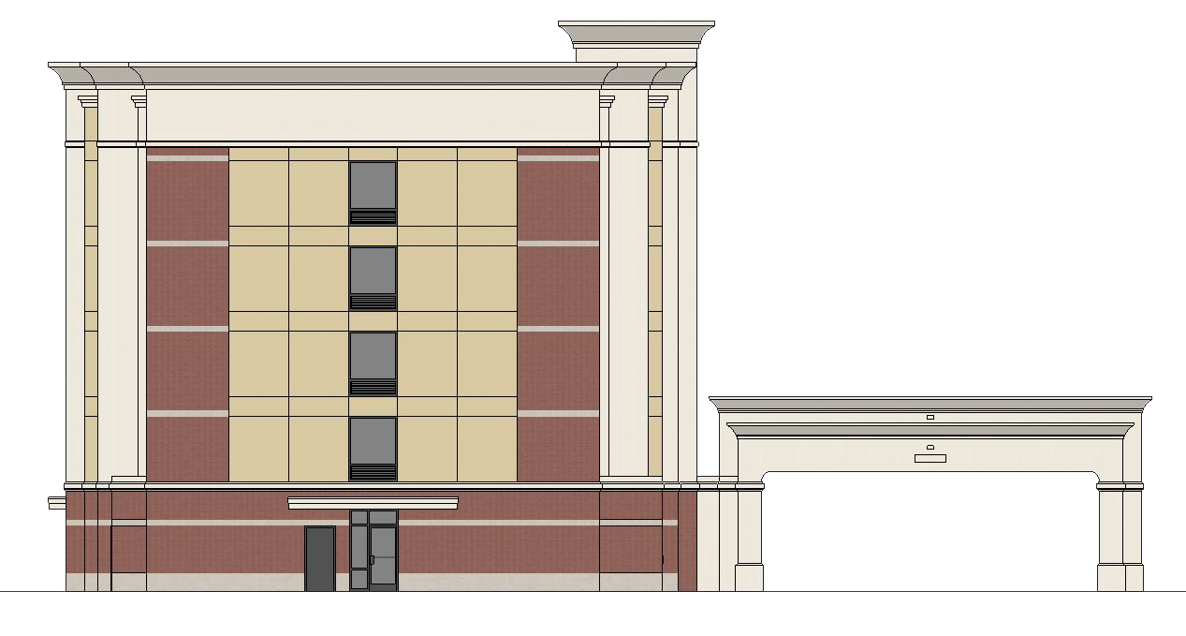
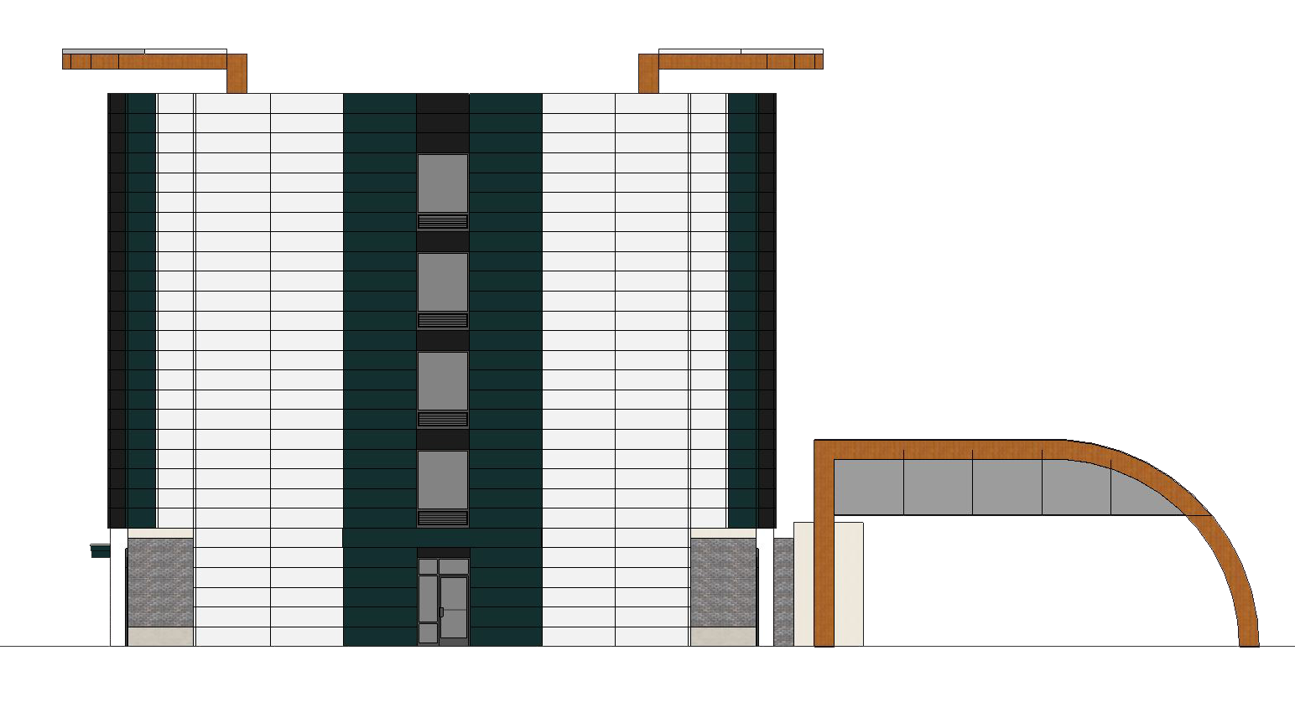
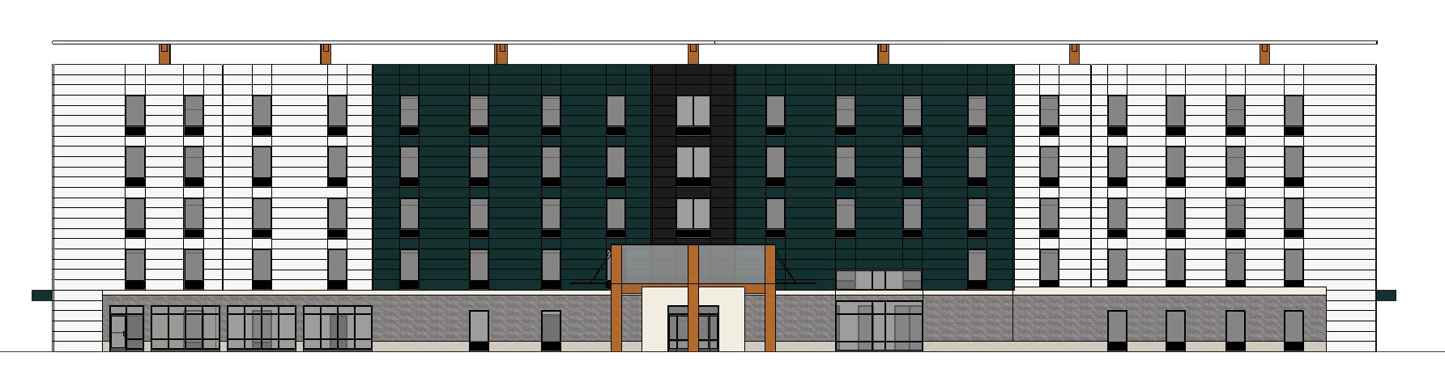
Hotel N.E.U.S.
Architecture
Elevations
Building Overview
Existing Building
Problem Statement
Proposed Solution
Redesign | Arch.
Conclusion

Slide 18
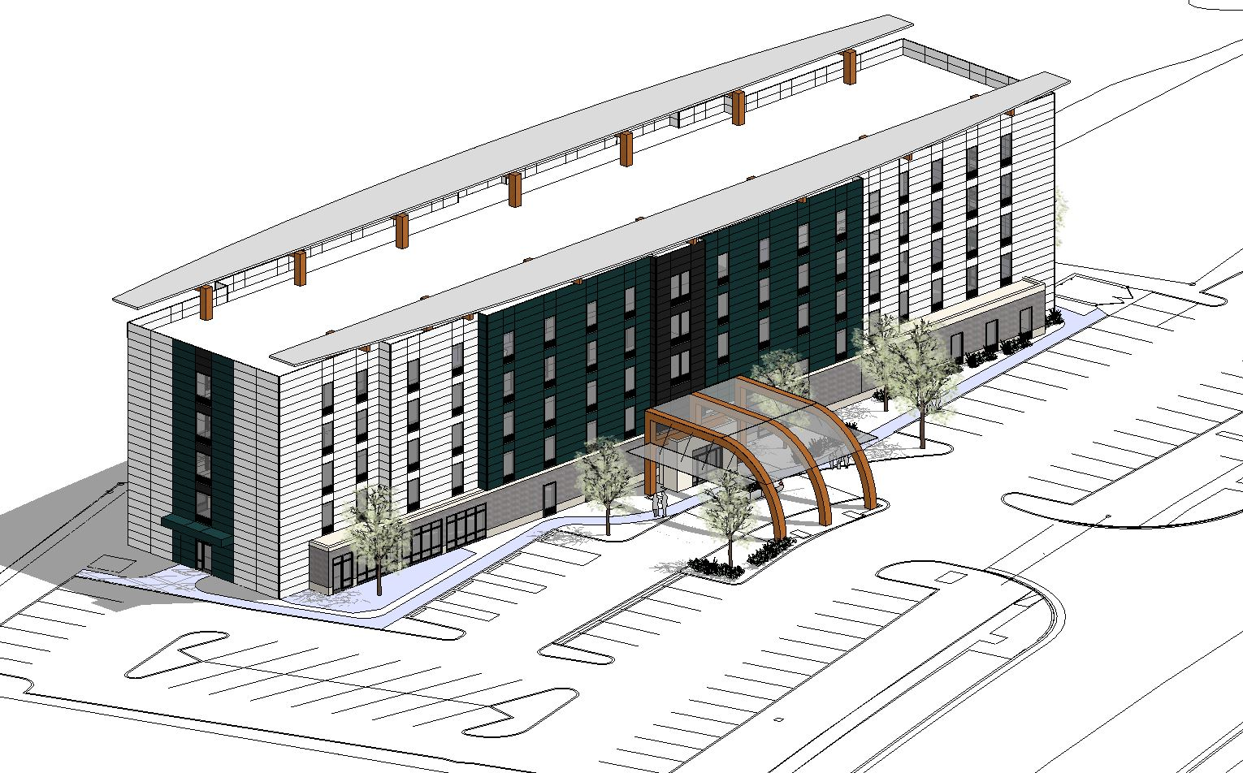
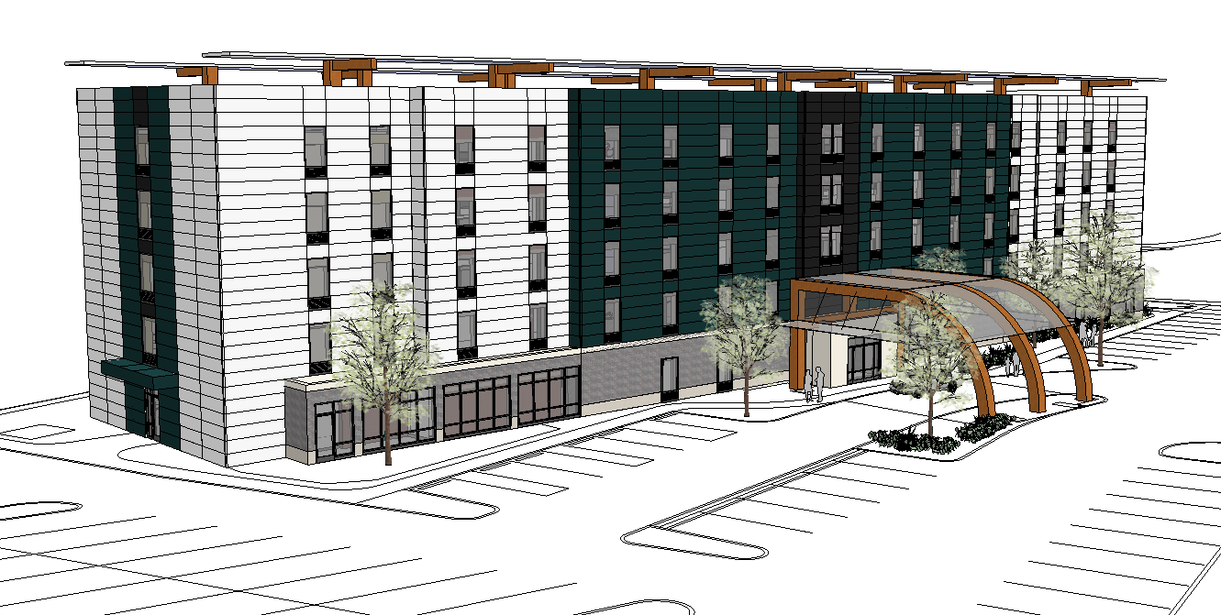
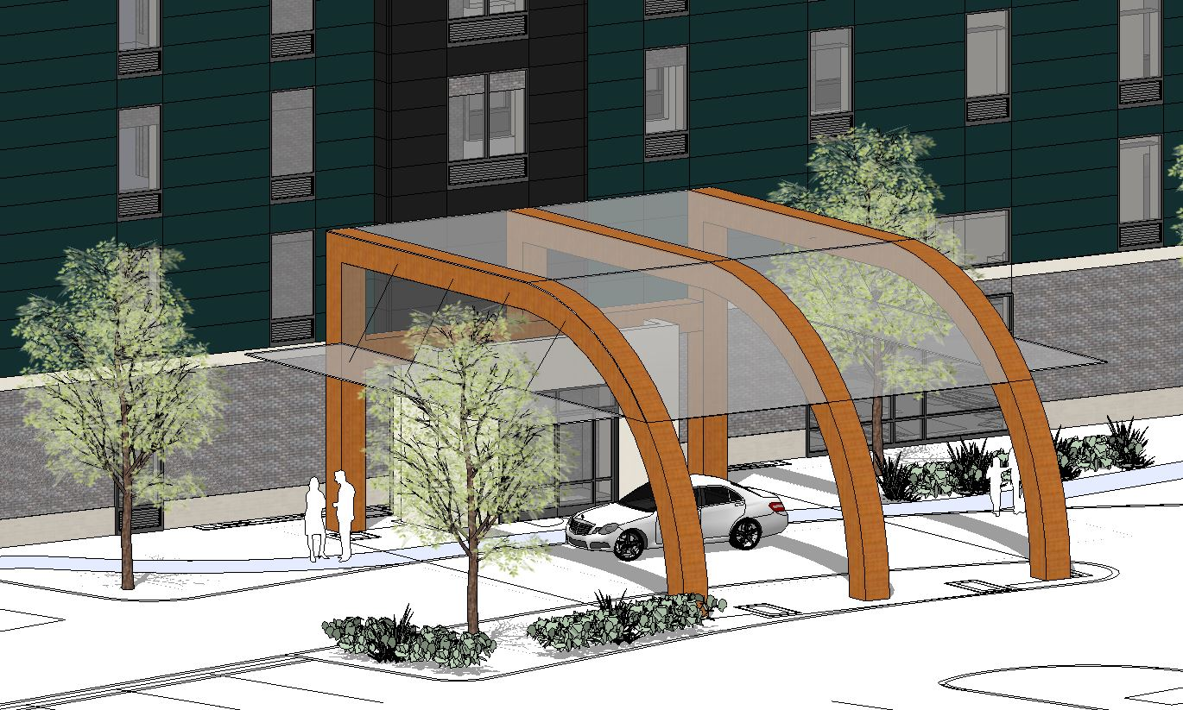
Hotel N.E.U.S.
Architecture
Building Overview
Metl Span Architectural Insulated Panels
  Grey, Green, and White
Grey Brick along base
Roof Awning
Entryway
  Tinted Structural Glass
Existing Building
Problem Statement
Proposed Solution
Redesign | Arch.
Conclusion

Slide 19
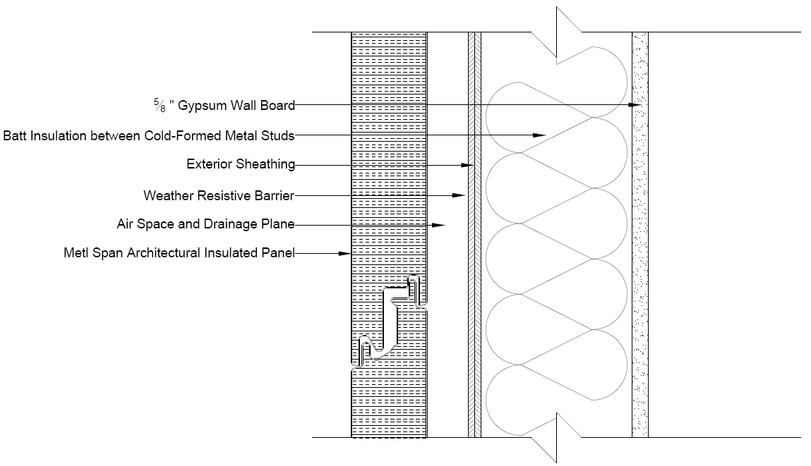
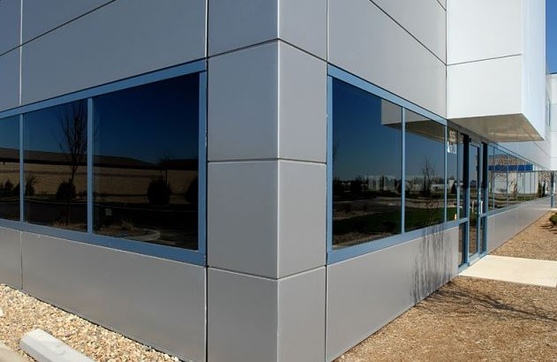
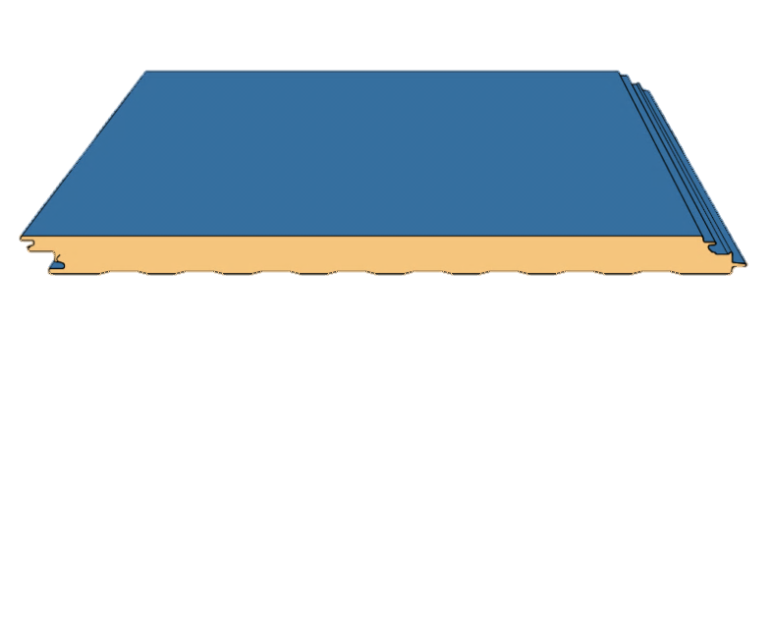
Hotel N.E.U.S.
Enclosure
Building Overview
Existing Building
Problem Statement
Proposed Solution
Redesign | Encl.
Conclusion

Slide 20
Hotel N.E.U.S.
Summary
Goals
Gravity system changed from precast plank and masonry walls to composite steel
Lateral system changed from masonry shear walls
  Short direction- Braced frames
  Long direction- Moment frames
Façade changed from EIFS to metal panels
Maintain floor plan and room sizes
Locate Braces within partitions
Limit drift for moment frames
Keep C.O.R. close to center of building
Redesign architecture
Redesign enclosure
Building Overview
Existing Building
Problem Statement
Proposed Solution
Redesign
Conclusion

Slide 21

Hotel N.E.U.S.
Acknowledgements
Atlantic Engineering Services:
Cam Baker
John Schneider
AE Department Faculty
Dr. Thomas Boothby
My family, friends, girlfriend, and God
Building Overview
Thank You
Existing Building
Problem Statement
Proposed Solution
Redesign
Conclusion

Slide 22
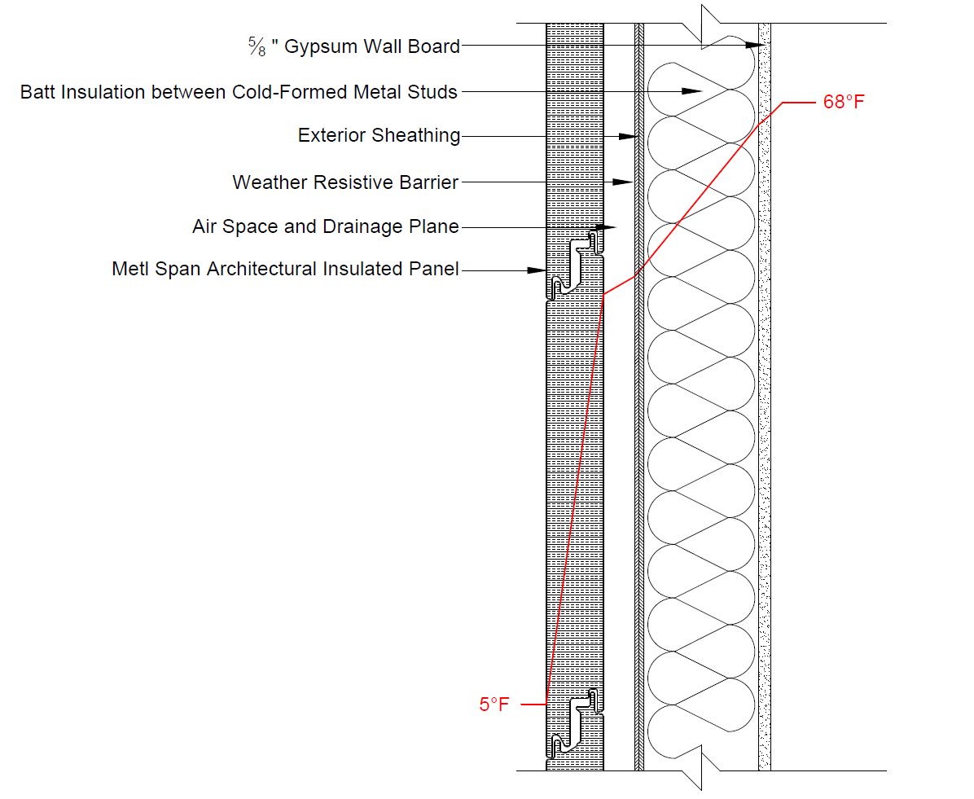
Hotel N.E.U.S.
Appendix
Seismic/Thermal
Building Overview
Existing Building
Problem Statement
Proposed Solution
Redesign
Conclusion

Slide 23
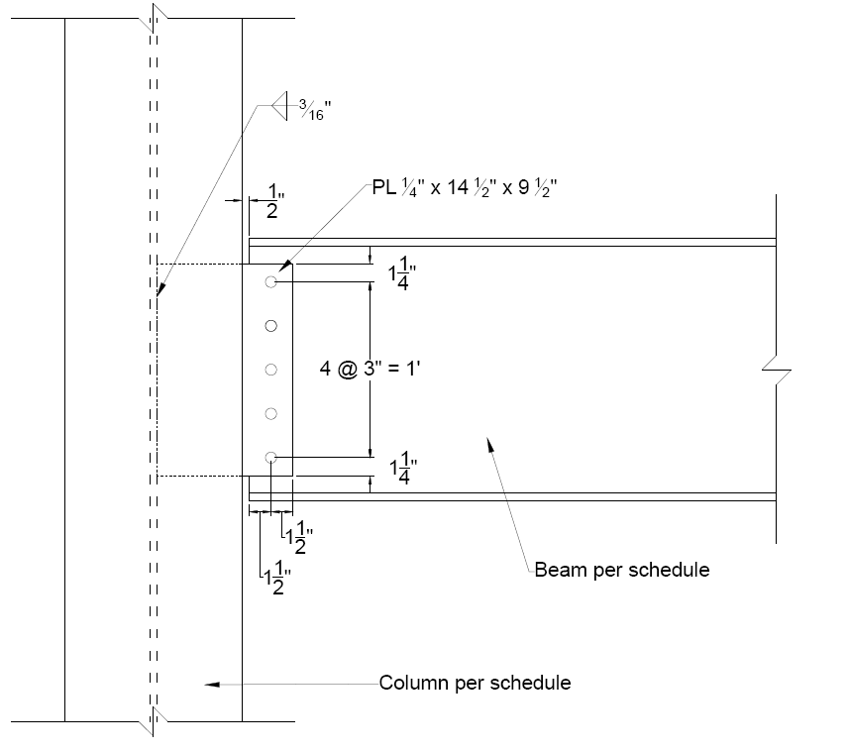
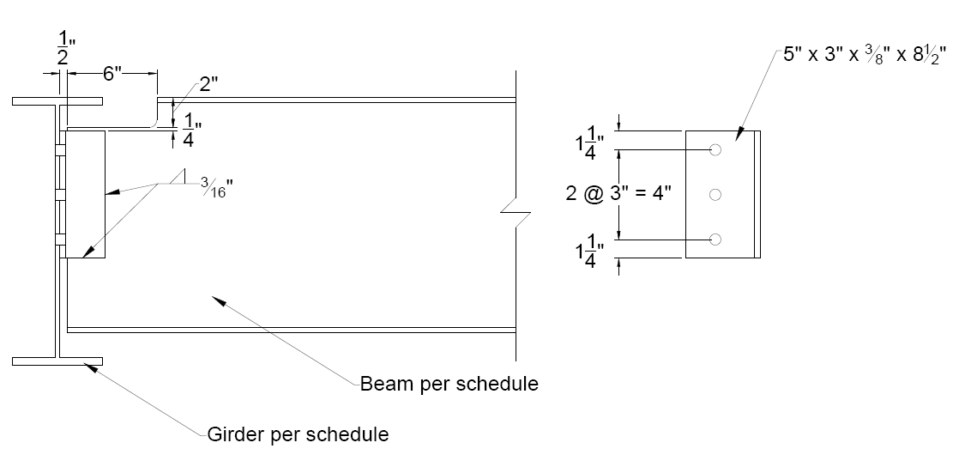
Hotel N.E.U.S.
Appendix
Gravity Connections
Building Overview
Existing Building
Problem Statement
Proposed Solution
Redesign
Conclusion

Slide 24
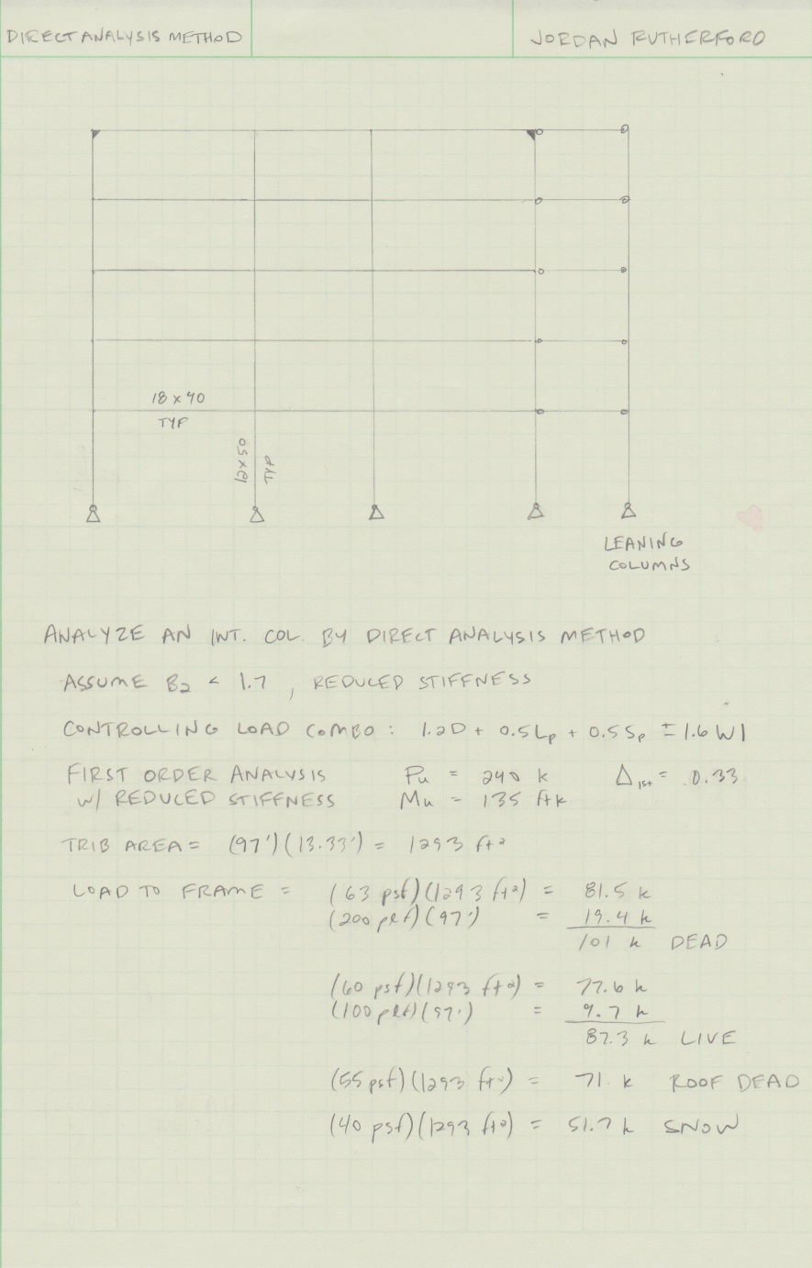
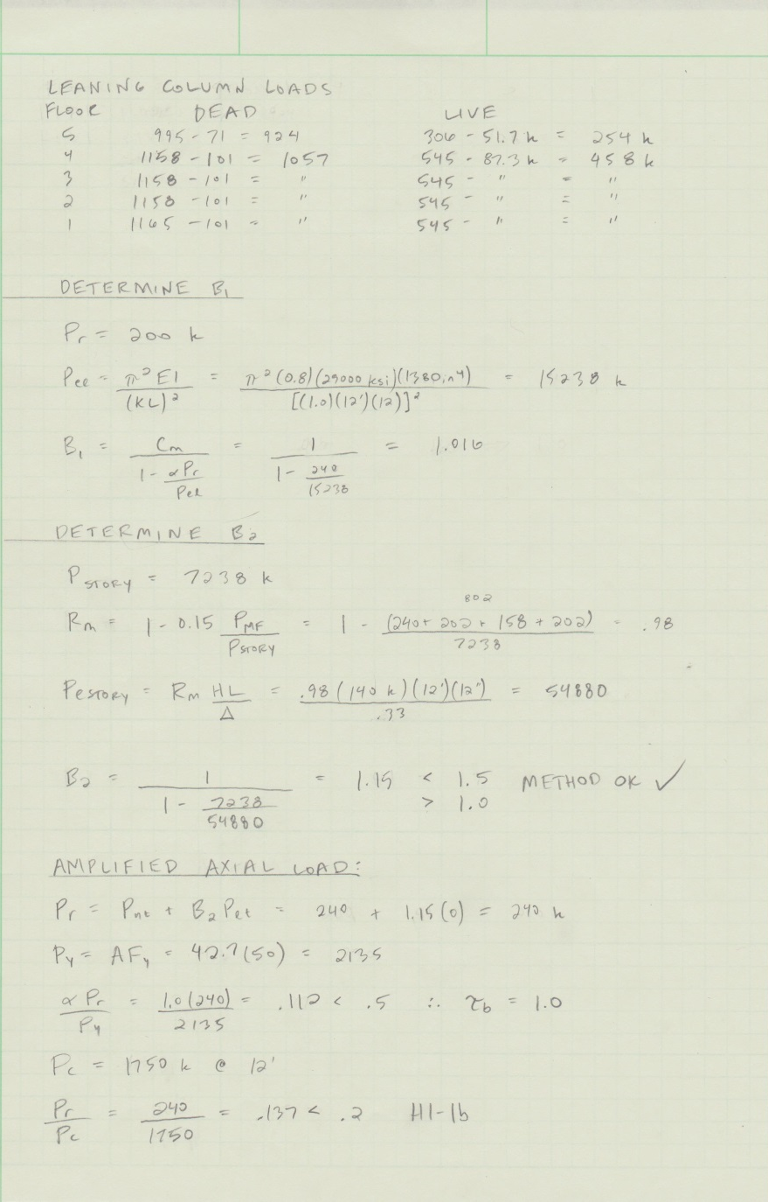
Hotel N.E.U.S.
Appendix
Lateral and Drifts
Building Overview
Existing Building
Problem Statement
Proposed Solution
Redesign
Conclusion

Slide 25
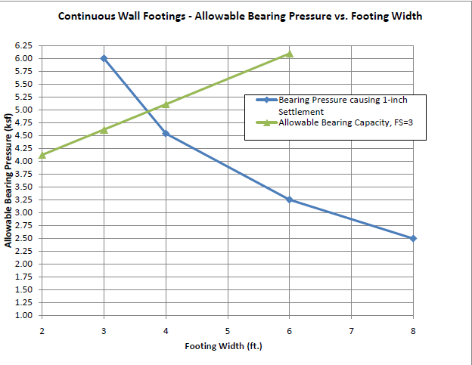
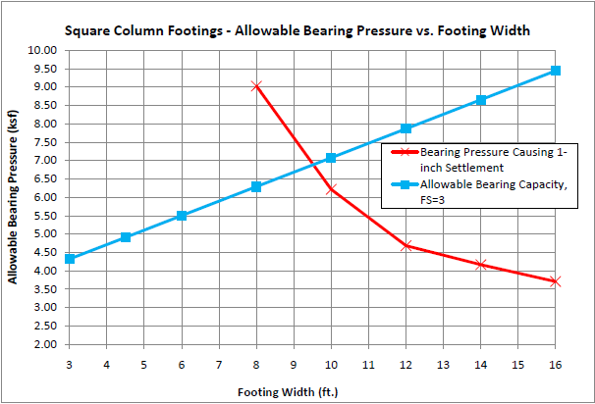
Hotel N.E.U.S.
Appendix
Footing Graphs
Building Overview
Existing Building
Problem Statement
Proposed Solution
Redesign
Conclusion

